Slide 1
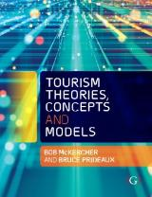

Chapter 2: What is tourism?

Slide 2
Learning Objectives
Identify and analyse the force field of tourism knowledge
Understand the development of myths about tourism and assess their validity
Identify the components of tourism
Distinguish between and critique heuristic and technical definitions of tourism
Explain the multidisciplinary nature of tourism
Demonstrate why pleasure tourism is an extreme form of leisure by explaining its evolutionary roots

Slide 3
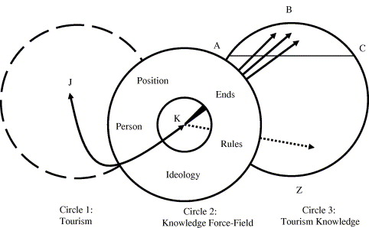
Gap between reality and ‘truth’
Forcefield of knowledge
Is it possible to tell the truth about tourism? Surely an elaborate and expensive knowledge production system (universities, research departments, journals, conferences) exists just for that purpose. But could it be that the thousands of research articles that have been published have failed to uncover the truth? (Tribe:2006)
Source: Tribe 2006

Slide 4
Tribe’s five elements of the force field
Person - all research is influenced directly or indirectly by the researcher.
    Impossible to separate the individual from the research process.
Rules - research is driven by a series of the accepted rules, traditions, methods and accepted protocols.
    Research grounded within some discipline-based concept, which in turn drives how research is undertaken.
Ends - the pursuit of knowledge is never interest-free.
Position - relates to both geographic as well as intellectual positions.
    Impact of ethnocentricity, departmentalism and academic tribalism.
Ideology - common sense set of beliefs (often implicit) permeating society which guides thought and action.

Slide 5
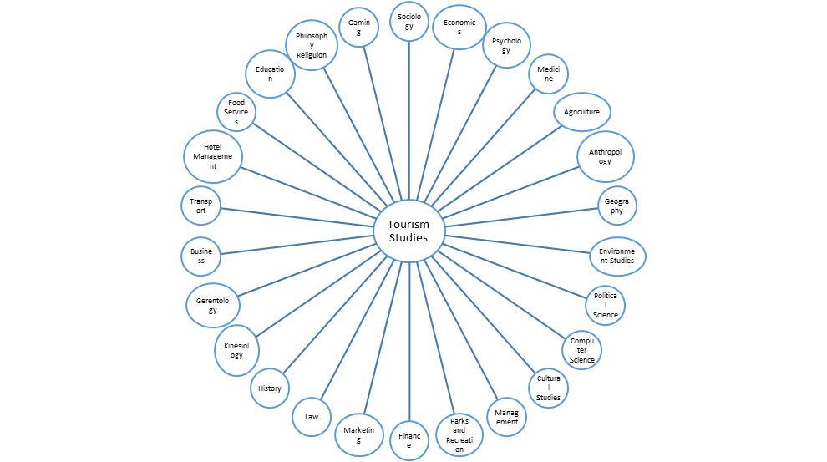
Tourism as an interdiscipline
No agreed upon definition
No single truth underlying tourism enquiry and as such, the field must be explored from various perspectives
No single discipline can accommodate, treat or understand tourism
Grew historically in a fragmented and disjointed manner driven by different disciplinary perspectives, institutional and political agendas and journals with different foci
Varied backgrounds of academics
Source: Chang et al 2011

Slide 6
Prof Brian King talks about tourism as an integrated field of study
https://www.youtube.com/watch?v=6GALzqmMmfA

Slide 7
Its diverse nature leads to a cautionary approach
Each discipline:
  staked a claim to certain areas of enquiry
  conceptualised them, examined them within their disciplinary bounds
  constrained research from within that discipline’s knowledge force field
The end result:
  tourism studies lacks a common language under which objects are defined and explored
  same terms are used to connote different ideas, while different terms are used to refer to the same thing
  definitions are often conflated
  the field remains beset by many ontological, epistemological and methodological shortcomings

Slide 8
Many myths drive tourism
Myths:
  Demonstrably false beliefs that are accepted as truths
  Have symbolic or metaphorical value that is greater than their absolute truth
  Set one field apart from another
  Legitimise a field of study
Causes:
  The origins of a discipline, where the work by many early scholars remains dominant
  Inertia
  Entrenchment by the peer review process and doctoral student training
  Self fulfilling prophecy research, where the assumption is that there is something out there and research sets out to prove the assumption
  Fallacy of misplaced rationalism
  False attribution of cause and effect without considering other causal agents

Slide 9
Examples of tourism myths
Type of Myth | Examples
Self Interest | Tourism is the world’s largest industry Tourism is an industry
Negative Foundation | Tourism destroys tourism Tourism perpetuates colonialism / tourism is neo-colonialism
Reactive Positive Stakeholder | Tourism is a path to economic independence Tourism revitalizes culture People damage the environment, not tourism
Convergent | Size, importance and differences of ecotourism/ecotourists and other forms of alternative tourism/tourists A traveller is better than a tourist
Too Good Not To Be True | Special interest tourism as the new mainstream Tourism and peace
Inherited | Relationship between satisfaction, loyalty, intent to return and actual repeat visitation rates

Slide 10
Prof Frederic Dimanche talks about the importance of meaningful research in tourism
https://www.youtube.com/watch?v=KxaiHN3A9gw

Slide 11
Defining tourism – why definitions are important
Components of a good definition
Precise Uses clear terms Falsifiable
Benefits to tourism / tourist of a good definition
Have a common understanding of the concept Use common language so different groups are talking about the same thing Set agreed upon boundaries to describe what is and is not included Describe and classify Count Analyse Determine how to examine Determine what to examine

Slide 12
Tourism is hard to define
Why?
Tourism is a complex and very fragmented activity
Inconsistent definitions hurt the development of the field
Loose boundaries and much overlap between what is and what is not tourism
Often very subjective and value laden term
  Tourist vs. traveler?

Slide 13
Start at the beginning
The word tour is derived from Latin - 'tornare' and the Greek, 'tornos'
  ‘A lathe or circle; the movement around a central point or axis'
  Tourism involves a round trip – not a one way journey
The suffix
  –ism is defined as 'an action or process; typical behaviour or quality'
  –ist denotes 'one that performs a given action'
Combining tour and–ism suggests the action of movement around a circle
Combining tour and–ist suggests the person doing the action

Slide 14
Two main types of definitions
Technical / Statistical
Heuristic
Attempt to define something and set exact boundaries so it can be quantified and analysed
Tends to be absolute
Designed to help with learning
Usually involves a careful description of the subject and a clear statement
Tends to be fuzzier

Slide 15
Need to consider both heuristic and technical definitions
 | Technical | Heuristic
Strength | Sets clear boundaries Can count tourists Can document tourist businesses Can calculate statistics and economic impacts Essential for census and statistical organisations Can calculate income, leakages, employment, etc. Allows business disciplines to study tourism | Inclusive Focus on the tourist Consider motivation Considers experience Considers impact Allows non-business disciplines to study tourism
Weakness | Exclusive Does not consider motivation Does not consider the tourist Does not consider experience Does not consider impact | Fuzzy boundaries Cannot count tourists Cannot conduct any economic or statistical analysis

Slide 16
Fundamentals of tourism (Netto 2009)
Subject - without tourists there would be no tourism Displacement – journey away Principle of return – return to origin Principle of motivation – may be explicit or implicit Principle of hospitality – in-destination and in-transit zones that serve the needs of the tourist Principle of experience – can be active or passive Principle of communication - with other tourists, workers in destination regions and others in order to have hospitality and experiences Principle of technology – uses some kind, transport and communications most common

Slide 17
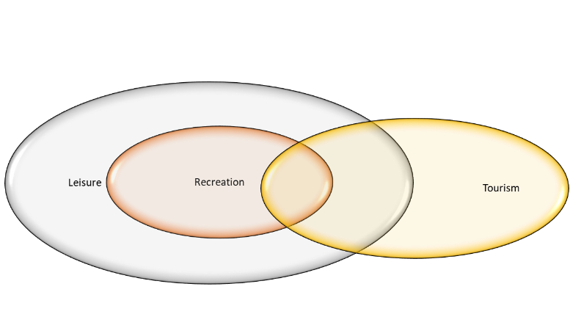
Pleasure tourism as an extreme for of leisure

Slide 18
Main difference between tourism and leisure/recreation
Tourism requires MORE:
  Time
  Effort
  Expense
  Commitment
  Pre planning
As a result, tourists expectations are GREATER, and the type of service or facilities they demand must be BETTER then they can find at home

